Slide 1

Introducing RAD studio 10.1 berlin

Slide 2
Presenter Name(s)
Brandon Shopp
brandon.shopp@embarcadero.com
Sarina Dupont
sarina.dupont@embarcadero.com
@sarinadupont
Marco Cantu
marco.cantu@embarcadero.com
@marcocantu

Slide 3
Agenda
RAD Studio Today
The focus of the product, including C++Builder and Delphi
The core value proposition
What’s New in RAD Studio 10.1 Berlin
Walk out of new features
Technical information
Demos

Slide 4
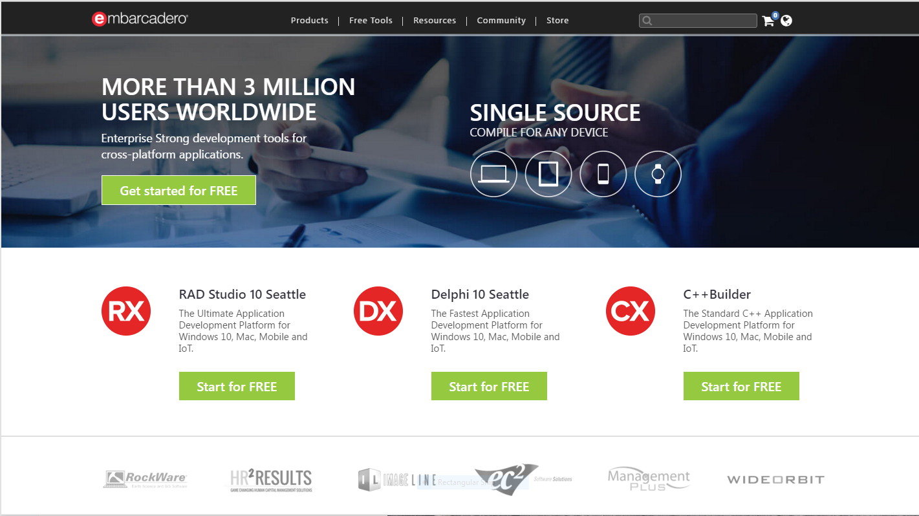
Embarcadero, Dedicated to developers
Embarcadero focus on developer tools
Database tools now part of the Idera portfolio

Slide 5
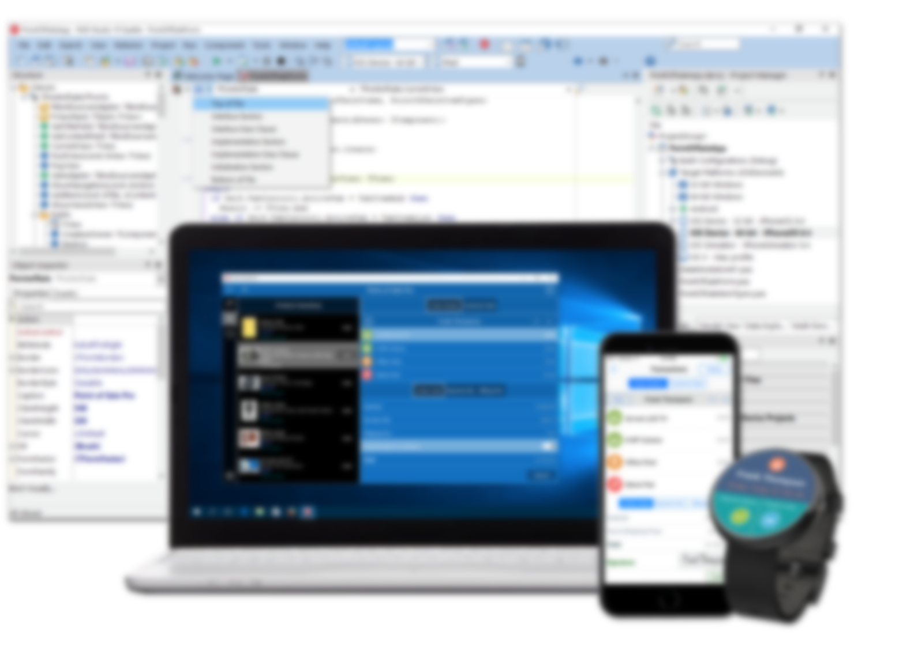



RAD Studio
Introducing RAD Studio, Delphi, and C++Builder

Slide 6
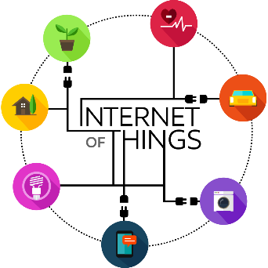

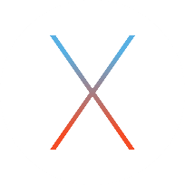



What is RAD Studio?
The fastest way to develop cross-platform Native Apps with flexible Cloud services and broad IoT connectivity
PLATFORM INDEPENDENT
CLOUD READY
CROSS
PLATFORM
NATIVE

Slide 7
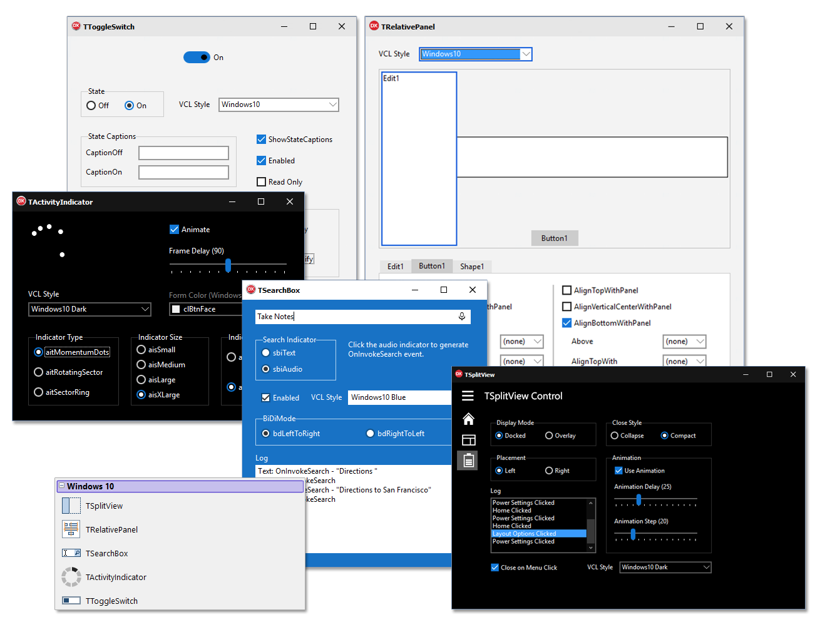
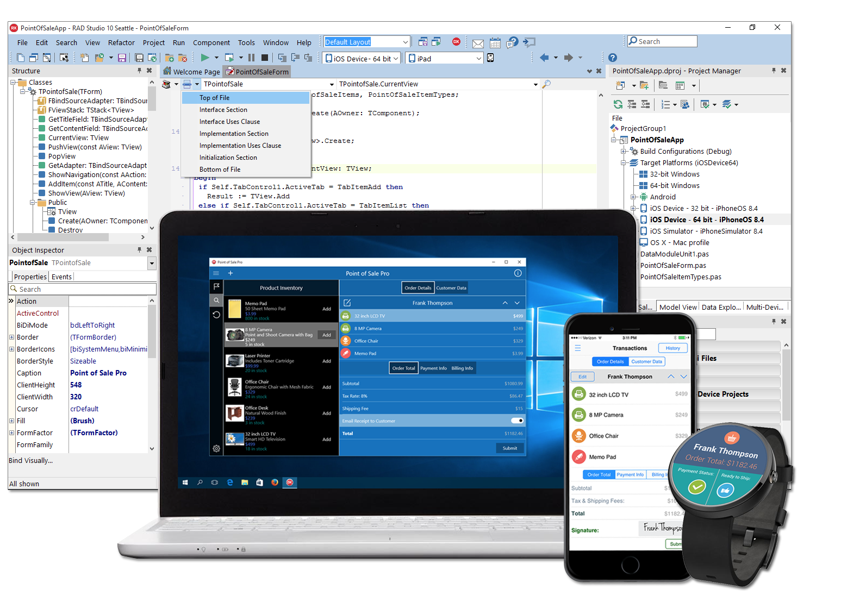
Fast, Visual Development
It provides powerful VCL controls for Windows 10 and enables FMX development for Windows, Mac and Mobile.

Slide 8
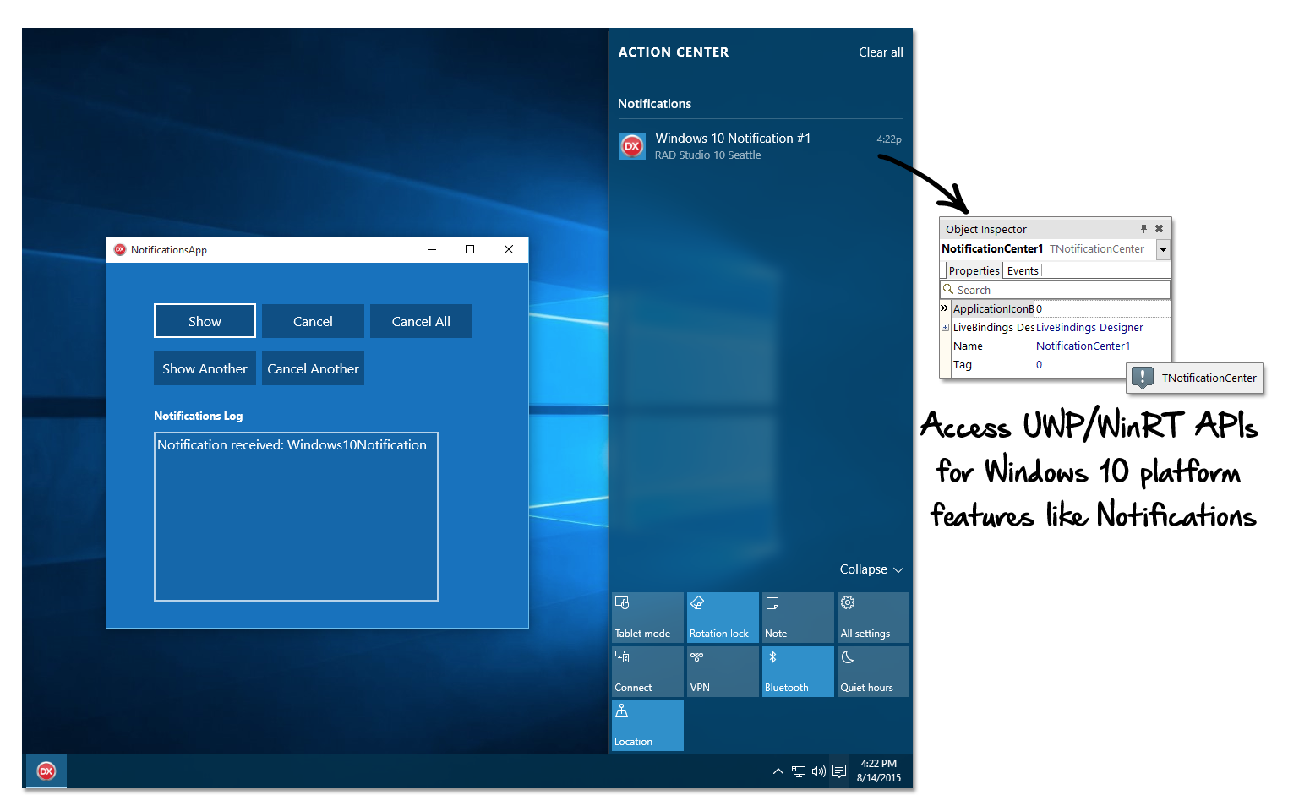
The best windows component library
VCL is the best component library wrapping the native Windows API and COM libraries
Component wrapping all common features
Extended custom and third party components
Windows 10 Support
WinRT integration
Windows 10 style controls
WinRT services components
Styling library for UI modernization

Slide 9
Cross-platform, native apps
CROSS
PLATFORM
NATIVE
Native platforms compilers for 4 operating systems, 32bit and 64bit CPUs, Intel and ARM CPUs
For maximum performance and security
Cross platform runtime library and database access
Memory, file system, threading, exceptions, data tables, XML, JSON, HTTP and REST clients…
FireMonkey visual component library
Flexible designers, styling, platform components
Write your UI once, customize at design time, deploy everywhere

Slide 10
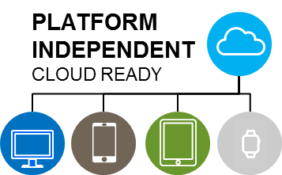
Cloud Services
AWS and Azure support
Access to storage, tables, queuing
BaaS providers
Including Parse, Kinvey
REST and HTTP client libraries for direct access
Based on platform libraries and including native HTTPS support
NoSQL database components
Full support for MongoDB

Slide 11
Broad Iot connectivity
Extend desktop and mobile apps with Internet of Things capabilities
Bluetooth, Bluetooth LE, and Wi-Fi
Ready-to-use IoT components
Proximity awareness, BeaconFence
Sensors data collection
Distributed device monitoring with ThingPoints

Slide 12

Outstanding Enterprise focus
FireDAC, Optimized Database access
All major enterprise RDBMS
Enterprise service architecture
RADServer, REST APIs
Redefining “Enterprise Strong Development”

Slide 13
It’s RAD! You Deliver Applications Faster
Rapid Application Development means fast development with solid architectures
RAD Studio delivers
5x the speed of development and deployment
Across multiple desktop and mobile operating systems
Across cloud and database platforms

Slide 14
10.1 berlin
What’s new in the current release of Delphi, C++Builder, and RAD Studio

Slide 15
rad studio 10.1 berlin at a glance
Core Themes
New install experience
Improvements in native toolchain and platform components
Internet of Things support
Additional Features
Developer productivity
Quality, performance, and stability (QPS)
Improved FireDAC Drivers

Slide 16
New install experience
RAD Studio 10.1 Berlin Core Themes

Slide 17
Why a new installer?
Old monolithic installer was slow, not flexible
Hours to install in most cases
New plan is to get started in minutes
Add platforms and features as needed
Initially or later on
Flexible updates of features
Better Trial
Create a better, more flexible, more modern trial experience

Slide 18
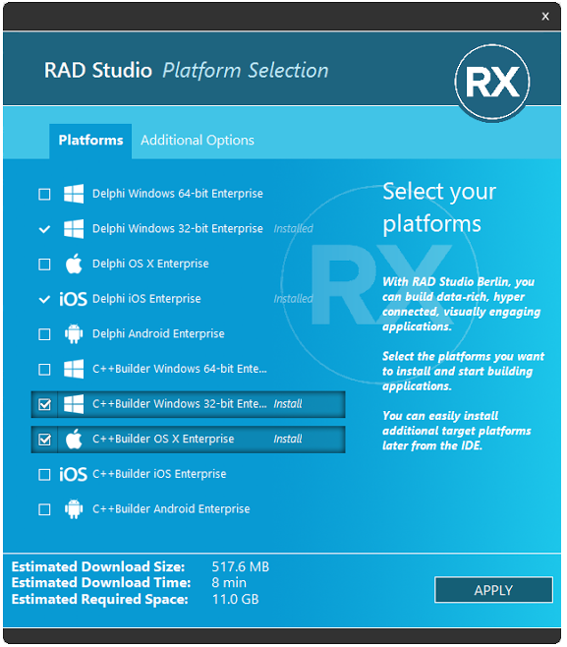
New Install Experience
Minimum Install + Platforms
Initial “minimum install” builds a bare, working system
Followed by platforms install
More platforms can be added any time
Based on GetIt technology
Traditional installer is still available (ISO image)

Slide 19
Native platforms enhancements
RAD Studio 10.1 Berlin Core Themes

Slide 20

RAD Studio 10 Compilers
Object Pascal and C++ Compilers
Windows 32-bit and 64-bit
LLVM-based C++ compiler for Win32 since 10 Seattle
Mac OS X
Android ARM v7
iOS Armv7, iOS Arm 64-bit
iOS Simulator (Object Pascal only)
7 Object Pascal and 7 C++ compilers

Slide 21


C++ Native toolchains enhancements
C++ Compilers
CLANG 3.3 and LLVM 3.3 support on all CLANG platforms
Complete C++ 11 language support
C++ support for Delphi RTL
Lambda Support (10 Seattle)
In place of Delphi Anonymous Methods
Parallel Programming Library
STL Iterators for Delphi types
Range-for available
Non-modifying STL algorithms: find, find-if, count, for_each, …

Slide 22
Delphi Native toolchains enhancements
Delphi Compilers
Utf8String type now also on mobile
1-byte string access, also RAWByteString
[weak] references for interfaces on all platforms
And [unsafe] interface references, too
[volatile] attribute for parameters and local variables
Core RTL
Shift of [weak] to [unsafe] for many component references

Slide 23
More RTL features
TBufferedFileStream for fast file read/write support
TStrings enhancements
AllNames, Options, AddPair fluent interface, and more
StringReplace and Pos performance enhancements
HTTP client library timeout and other improvements

Slide 24
Why mobile and firemonkey?
Mobile platforms are the fastest growing operating systems
Close to 2 billion active users on Android and iOS
Apps remain the preferred mobile technology
Native apps can leverage the device capability
FireMonkey platform offers single source support for mobile and even desktop
Delphi and C++Builder offer seamless migration to mobile, integration of mobile and desktop apps

Slide 25
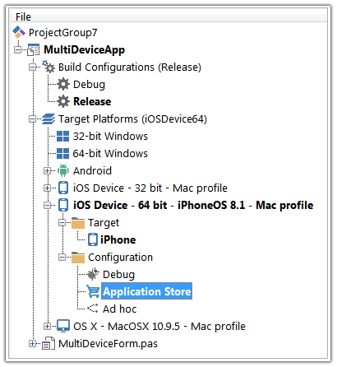
RAD Architecture: The FireMonkey Platform
Single-source multi-device architecture
Including user interface controls, which can be styled or platform native
Multiple compilers for the different platforms, all producing native code
RAD, with a strong OOP architecture
For Windows, OS X, Android, iOS

Slide 26
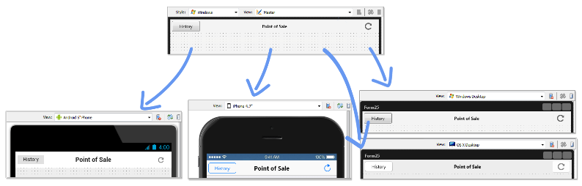
Best in Industry: FireUI Multi-Device Designer
FireUI: Shared master and specific views
Visually customize forms for different platforms and form factors
Brand New: FireUI multi device preview and FireUI App preview on device

Slide 27
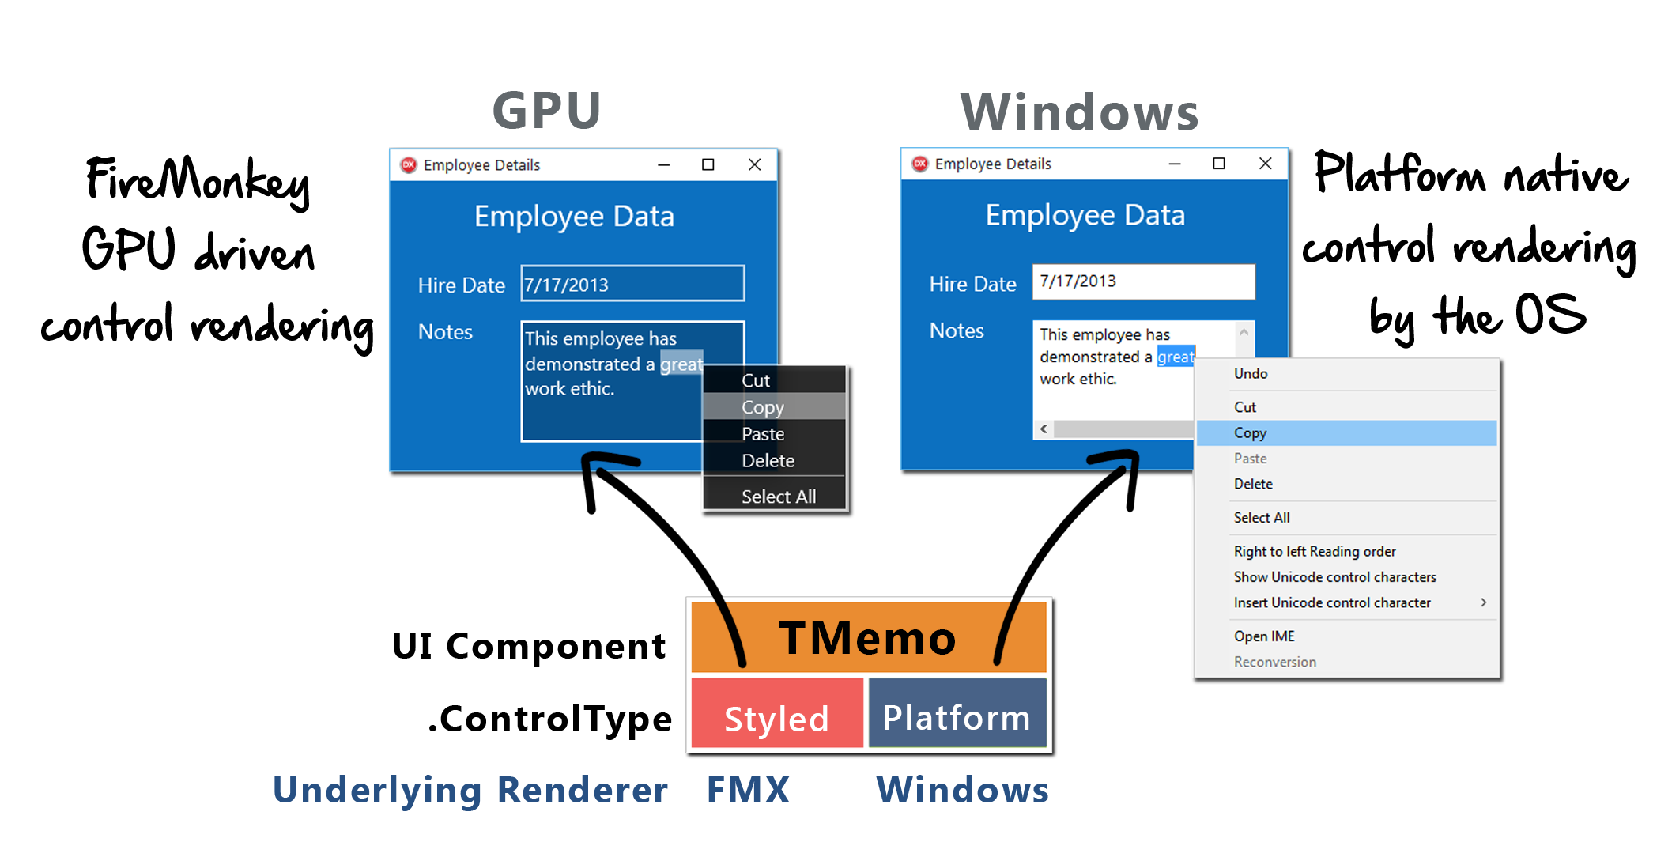
FireMonkey Platform Native Rendering Architecture
Currently available on iOS and Windows

Slide 28
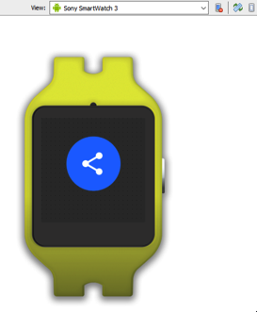
New in 10.1 berlin for FireMonkey
Enhancements for all platforms: Win, Mac, Mobile
FMX Address Book/Contacts component
FMX Style Designer improvements
ListView Items Designer
New font styling
And more…
Multi-Device Designer Improvements
FireUI App Preview on Device
Android Wear Styling and new FireUI views

Slide 29
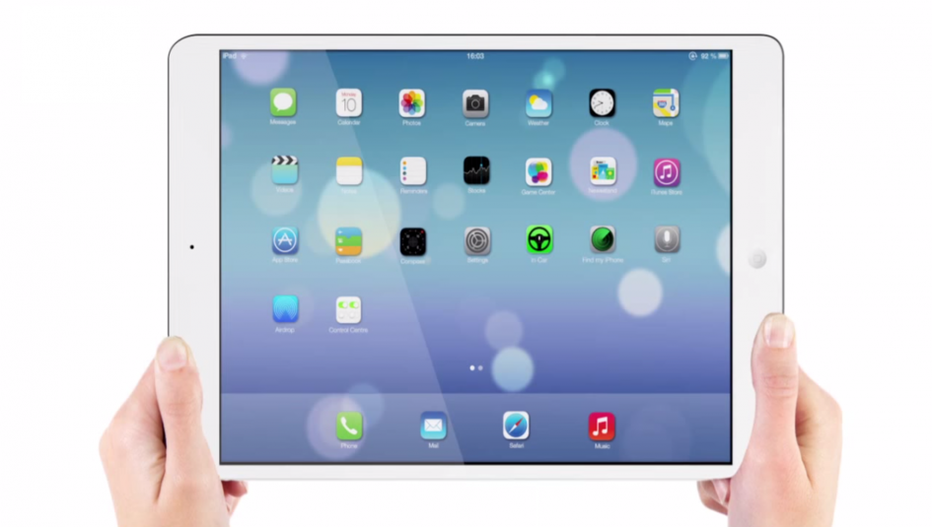
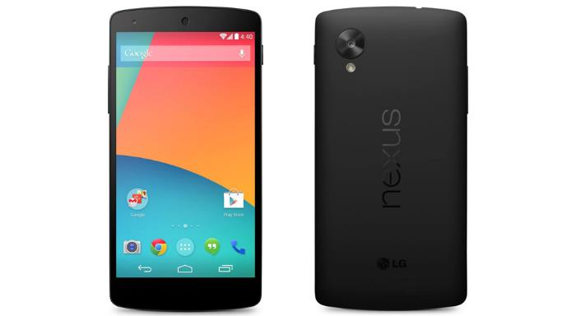
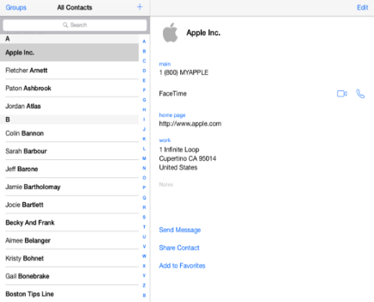
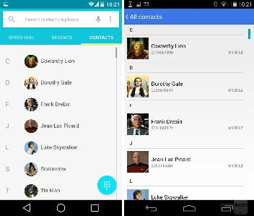
TAddressBook
A new non-visual component for working with native mobile OS Address Book data

Slide 30
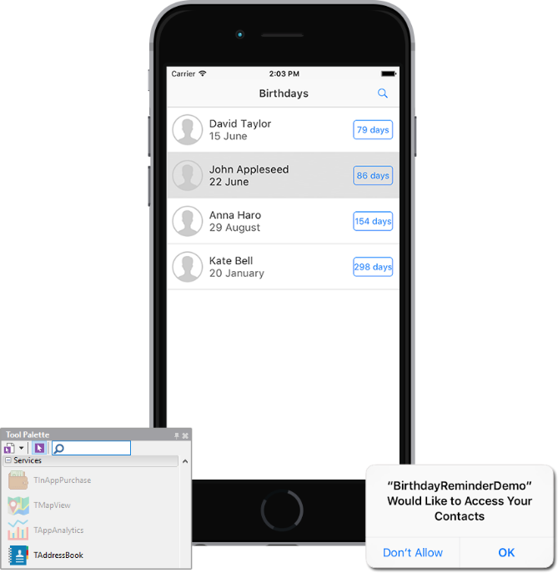
What can I do with taddressbook?
Fetch all contacts from phone or tablet
Fetch all contacts in specified group/groups
Create new contact and add it to Address Book
Get existed contact, modify and save
Remove contact
Fetch all groups (a Group is a logical union several contacts)
Change name of group and save
Remove group
Request permission for working with AddressBook data
Get information about current permissions
Learn when other process or client changed data in AddressBook

Slide 31
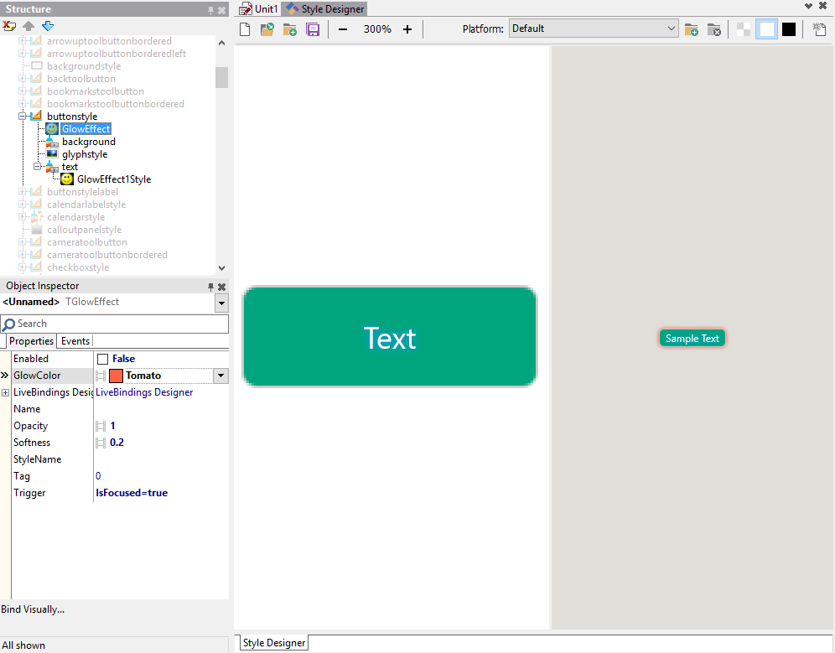
Enhanced style designer
Wholly redesigned FireMonkey IDE integrated style designer
Uses existing structure view and selectors
Feels more natural to work with

Slide 32
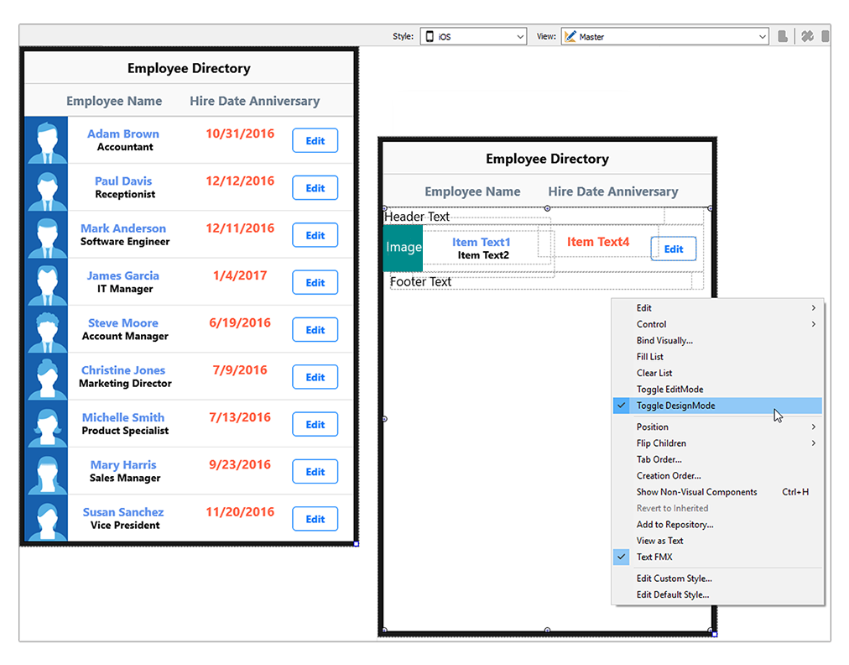
New Listview Item designer
Edit structure of listview items in place by toggling design and edit mode
Extended flexibility in list view items structure

Slide 33
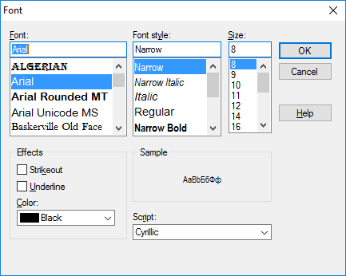
Firemonkey Font Styles with font faces support
TFont.Style property
Regular styles
TFont.StyleExt property
Supports font faces
TFontStyleExt = record
SimpleStyle: TFontStyles;
Weight: TFontWeight;
Slant: TFontSlant;
Stretch: TFontStretch;
end;

Slide 34
More firemonkey features
New dialog services
Extended clipboard services
For text, images, and custom formats
Support for accelerator keys on Windows
And focus controls support for labels
Touch animation support for ListView

Slide 35
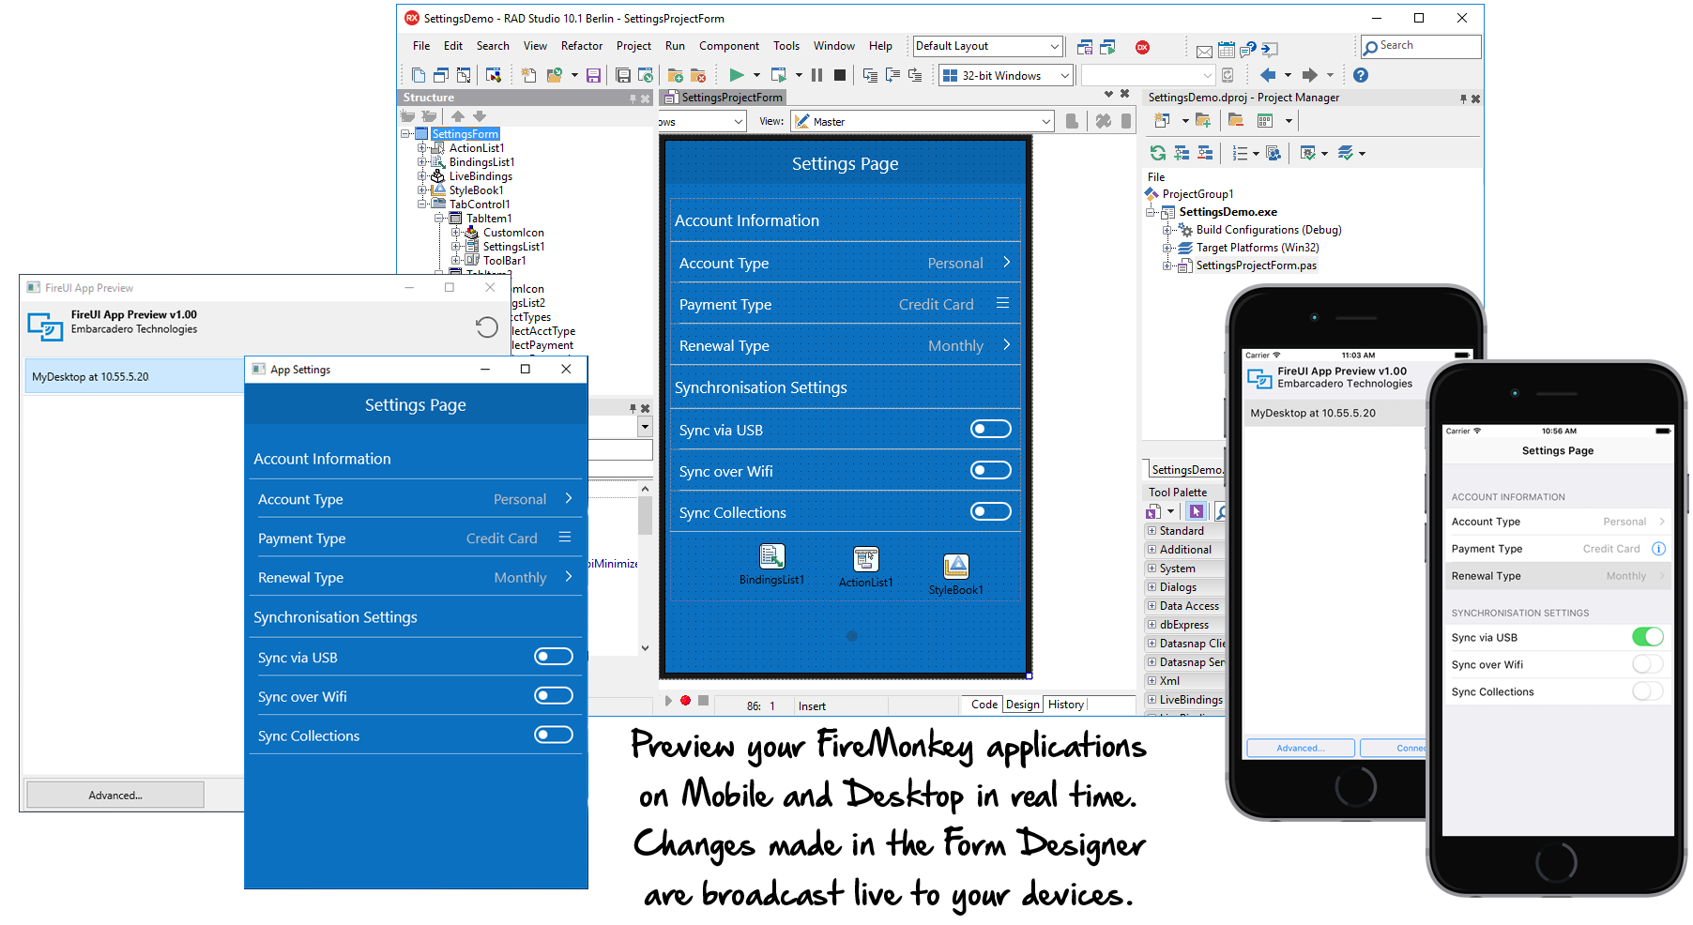
FireUI App Preview (on device)

Slide 36
Why Windows 10?
The fastest adoption rate for Windows
270 Million Windows 10 devices as of March 30th 2016
Gaining enterprise adoption
VCL offers the best migration path to Windows 10
Still retaining support for older versions of Windows
Deploy to Windows 10 store via project Centennial (coming from Microsoft)

Slide 37
RAD Studio Windows 10 Support
Unparalleled support for Windows platform
The VCL is the best and most complete component library for native Windows
Integrating Win32, Win64 and also WinRT APIs
Windows 10 Specific Components
New Windows 10 UI controls
Windows 10 notifications and contracts components
Available since 10 Seattle

Slide 38
Native Windows / VCL in 10.1 berlin
Improvements in WinRT bridge
Bluetooth LE support for Windows 10
More platform APIs
And also DirectX 12
Further scaling, HighDPI and Multi Monitor support improvements

Slide 39
Internet of things
RAD Studio 10.1 Berlin Core Themes

Slide 40










Why iot?
“Internet of Things”: today’s largest growing IT area
Underneath the hype, some core great technologies becoming cheap and ubiquitous
Automate tasks, automate life
Distributed computing power: smarter sensors, makers boards, mobile devices…

Slide 41
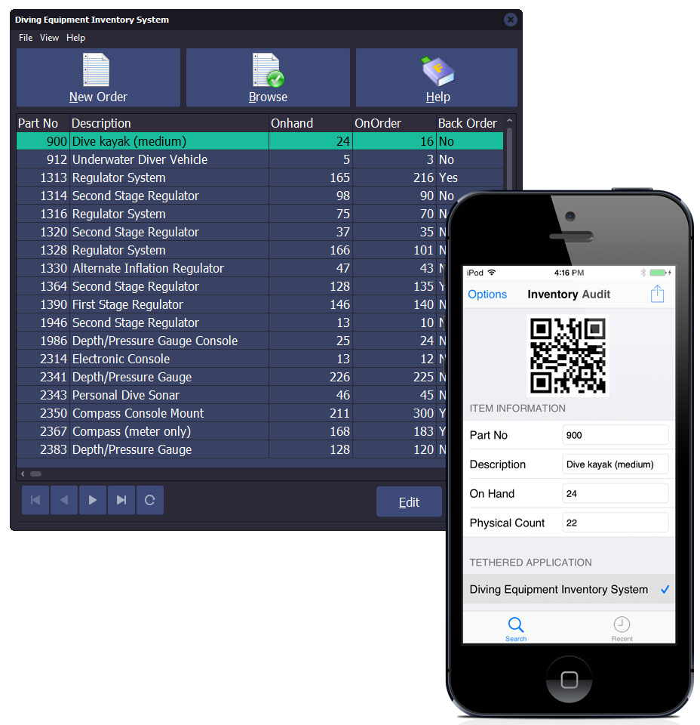


RAD Studio RTL Connectivity and IoT
AppTethering
Including protocol enhancements, encryption hooks
Bluetooth
With TBluetooth and TBluetoothLE components, Beacons support, and more
Wi-Fi
Connect via HTTP and REST client libraries to TCP/IP-based devices

Slide 42

New Iot features in 10.1 Berlin
Extensions to current foundations
More Bluetooth LE standards and features
Improved Android Wear support
New IoT architecture
Metadata-driven components generation
Downloaded via GetIt
ThingPoints: RAD Servers (EMS) distributed extensions

Slide 43
What’s new for Bluetooth in 10.1 berlin
Bluetooth LE support in Windows 10 / WinRT
Support for Bluetooth advertisement
Beacons
Support for EddyStone Beacons (new Google format) for both iOS and Android
Support EddyStone UID, URL, Telemetry
BeconFence improvements

Slide 44
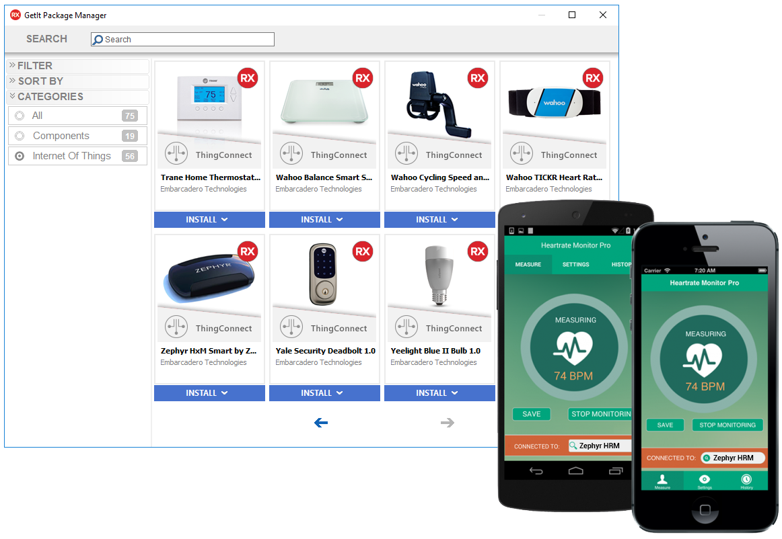

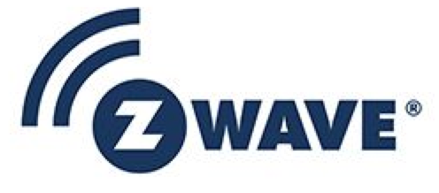
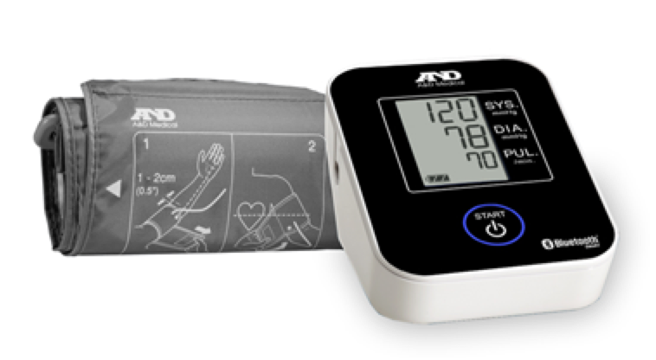


ThingConnect IoT Connectivity Framework
Turns off-the-shelf and custom IoT smart devices, sensors, and wearables into easy-to-use API components

Slide 45
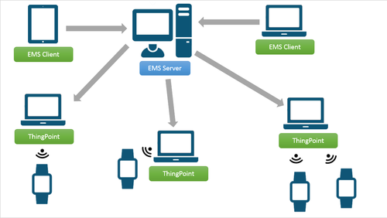
ThingPoint: edge services
Software stack for building and deploying edge modules
Collect data from nearby devices into enterprise backbone
Pre- and post-process collected data
Filter data based on several criteria
Cache edge data in a SQL database (ThingBase)
Communicate with EMS server bi-directionally through REST APIs

Slide 46
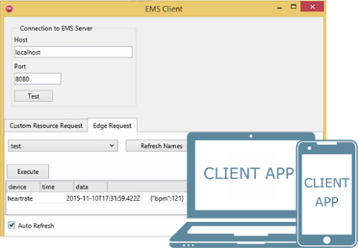
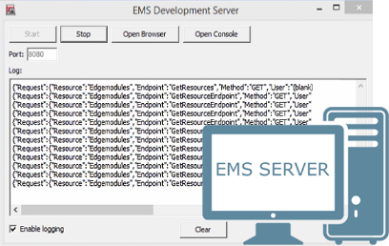
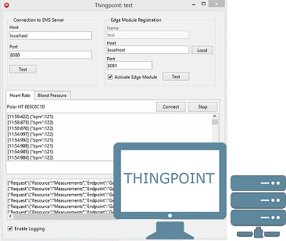

IoT Edge Data Flow
Client
RAD Server (EMS)
ThingPoint
Smart Device
iOS/Android/Windows/
Mac app
Windows IIS Server/
Apache for Windows
Windows/
Mac
Smart Device #1
Wi-Fi/
Cloud
Wi-Fi
Bluetooth/
Z-Wave
Smart Device #2
Smart Device #3

Slide 47
RAD Server
Sneak Peek!
RSX
Modern Multi-Tier Made Easy

Slide 48
RSX
RAD Server Multi-tier Made Easy
THE PERFECT BACK-END FOR DELPHI AND C++BUILDER APPS
RAD Server is the turn-key RAD application server that provides a robust “out of the box” back-end platform on which to build and deploy your Delphi and C++Builder application services. With RAD Server there is no longer a need to build your own back-end servers and services. Instead simply load Delphi and/or C++ methods into RAD Server and publish your back-end code to any client via managed REST/JSON end-points. Built-in services and integrations provide all the most common functionality and access to key external systems. All in a single easy to use and easy to deploy server.
REST End Point Publishing
An all-in-one turnkey foundation for your application back end APIs and Services.
Integration Middleware
Integrations provide out of the box connectivity with external servers, applications and services.
Application Services
A collection of ready to use key built-in services to power your application. Includes core functions such as user directory services and user management, push notifications, user location tracking, and built-in data storage.

Slide 49
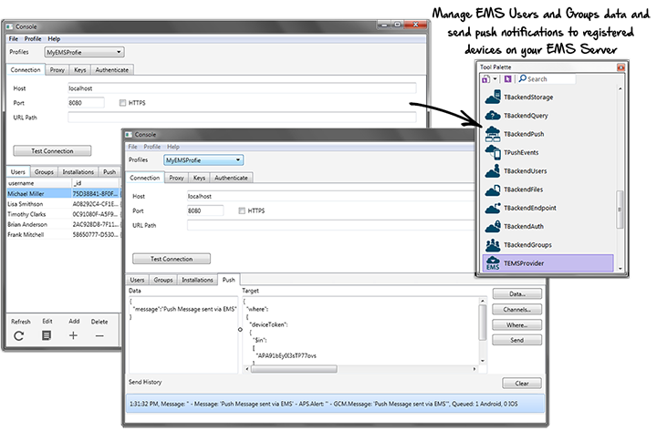
REST End-Point Publishing
Easy REST API End-Point Creation, Publishing, and Management
RAD Server makes it fast and easy to build flexible back-end servers for your multi-tier application solution. Developers simply load Delphi and C++ business logic into the server, and managed REST/JSON API end-points are generated. Developers or admins can easily configure API level access control to user groups, and measure and analyze application usage at the API, user, or service level. Since your Delphi and C++ APIs are published as heterogeneous REST/JSON end-points, RAD Server easily supports virtually any client type from VCL and FMX Desktop, Mobile and Wearable clients to popular JavaScript Web Frameworks. RAD Server easy to build and deploy robust heterogeneous multi-tier solutions.
{API}
REST End-Point Publishing
API Analytics
Easy to use API publishing of business logic. Any Delphi or C++ code can be hosted as an API and auto-published as REST/JSON endpoints which are measured and managed by RAD Server.
All REST API end-point activity is recorded and measured for robust statistics tracking and analytics. Analyze user, API, and services activity to gain insight into how your application is being utilized.
Access Control
Desktop, Mobile & Web
Group and user level access to control to all application APIs. Control who has access to what functionality. All access is user authenticated.
All C++ and Delphi code hosted on RAD Server are published as REST/JSON end points consumable by any type of client for extreme flexibility and future-proofing.

Slide 50












Integration Middleware
HIGH PERFORMANCE INTEGRATION WITH DATA, CLOUD, AND SMART DEVICES
RAD Studio includes high performance integrations that make it easy to connect Enterprise Data, Cloud Services, and Smart IoT devices into your multi-tier application. RAD Studio’s Enterprise DACs enable fast pooled connections to Oracle, Microsoft SQL Server, DB2, Sybase, and more. Client connection pooling also eliminates complex and heavy weight RDBMS client drivers and configurations. Clients applications connect to RAD Server via lightweight REST for data access, application services, and application API calls. RAD Server includes the new IoT ThingConnect and ThingPoint IoT Edgeware making it easy to connect a wide array of wireless smart devices and sensors into your application solution, even in remote and difficult to access locations.
Enterprise SQL Data Access and Connection Pooling
High performance built-in connectivity to all popular Enterprise RDBMS servers. Based on FireDAC developers have easy application connectivity and a wealth of features working with data from a variety of sources. Connection pooling vectors client connections thru your application middleware conserving connections and simplifying configuration and client deployment
Your Application
IoT Smart Devices
Cloud Services
IoT Connection components enables fast and easy integration of IoT Smart devices into your app clients or back-end. RADServer’s IoT Edgeware extends it’s reach to where your Bluetooth IoT devices are physically located.
Easily integrate REST cloud services from a variety of cloud, social, and BAAS platforms such as Google, Amazon, Facebook, Kinvey, Parse, and more.

Slide 51
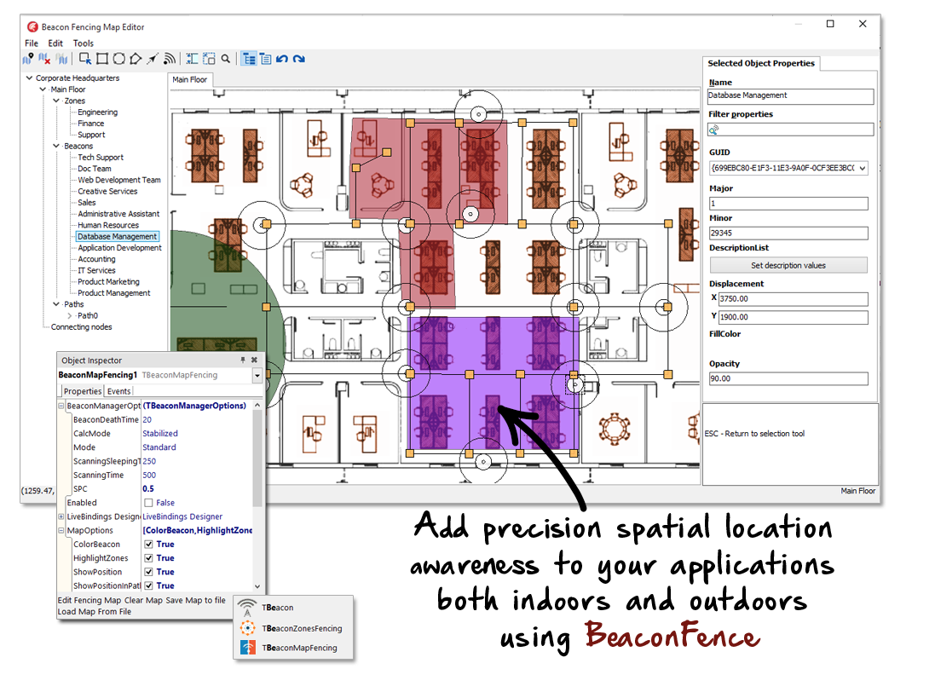
Core Application Services
KEY BUILT-IN CORE SERVICES TO POWER YOUR APPLICATION
RAD Server includes a powerful set of built-in core servers to power your application back-end eliminating the need to build the key foundational components of your server application. Core services like User directory services, authentication, and access control, push notifications, JSON data-storage, and user proximity and indoor/outdoor user location tracking and fencing.
Push Notifications
JSON Datastore
Send programmatic or on-demand notifications to your application users.
Easily store and retrieve JSON data securely and without requiring a separate database server.
User/Group Management
User Location/Proximity
Create and manage users, groups, and access control via the RADServer management portal.
Track user movement both indoors and outdoors, and respond to proximity events when users enter or exit custom beacon zones or approach designated beacon points.

Slide 52
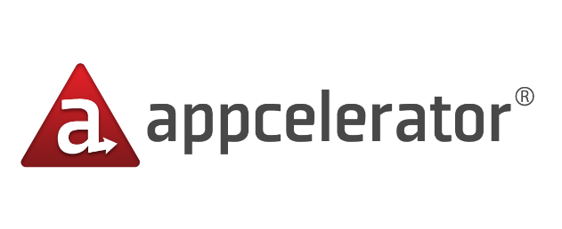



Other Back-end Servers
Kony - $23k
Appcelerator - $60k
HP - $75k
IBM - $110k

Slide 53
RAD Server Made Affordable
SIMPLE TO USE. SIMPLE TO BUY.
Less than $99 per device
or
1.1
Less than $5k per server with unlimited users/devices

Slide 54
RSX
RAD Server Coming Soon
^
VERY
RAD Server launching in Q2 2016
10.1
But Developers can get started now with Berlin!
All RAD Server development features are included in Berlin!

Slide 55
Additional features
From Developer Productivity to Quality

Slide 56
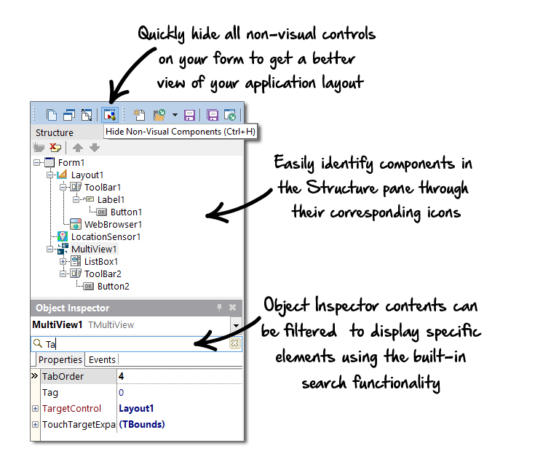
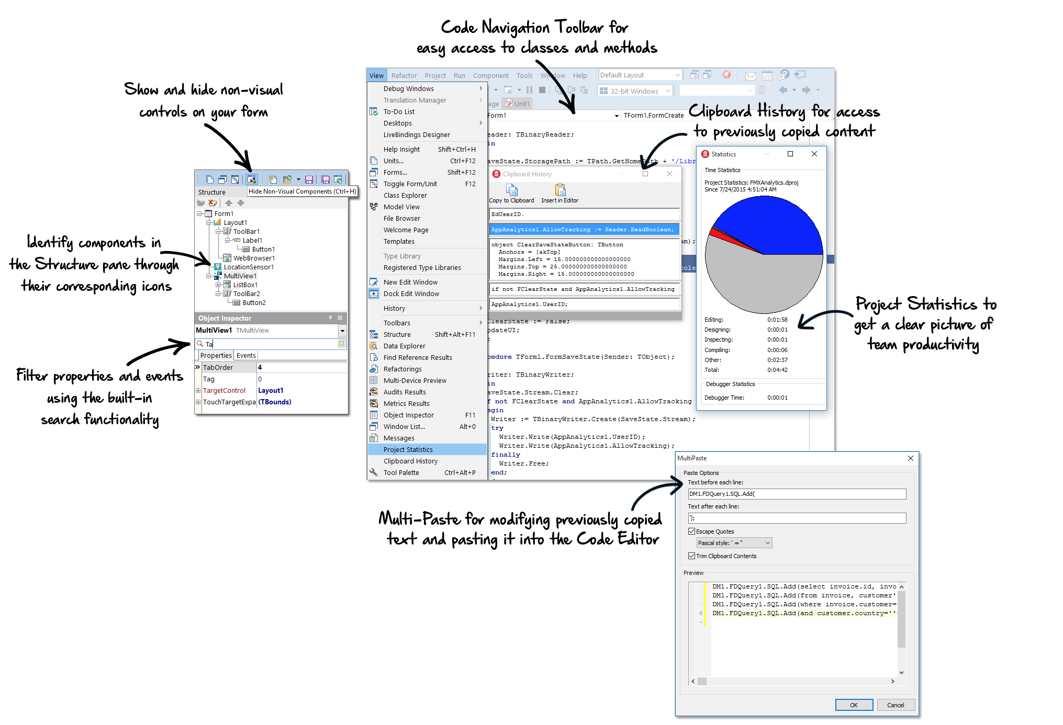
10 Seattle IDE Productivity Enhancements
Twice the memory, Object Inspector, productivity features, multi-monitor support…

Slide 57
10.1 berlin Productivity enhancements (I)
Areas we already covered…
The new installer and the enhanced GetIt Package Manager
The FireUI App Preview on Device
New minimalistic welcome page
Separate form designer for VCL and FMX
Optional, great for multi-monitor
HighDPI support improvements
Visual Live Bindings improvements

Slide 58
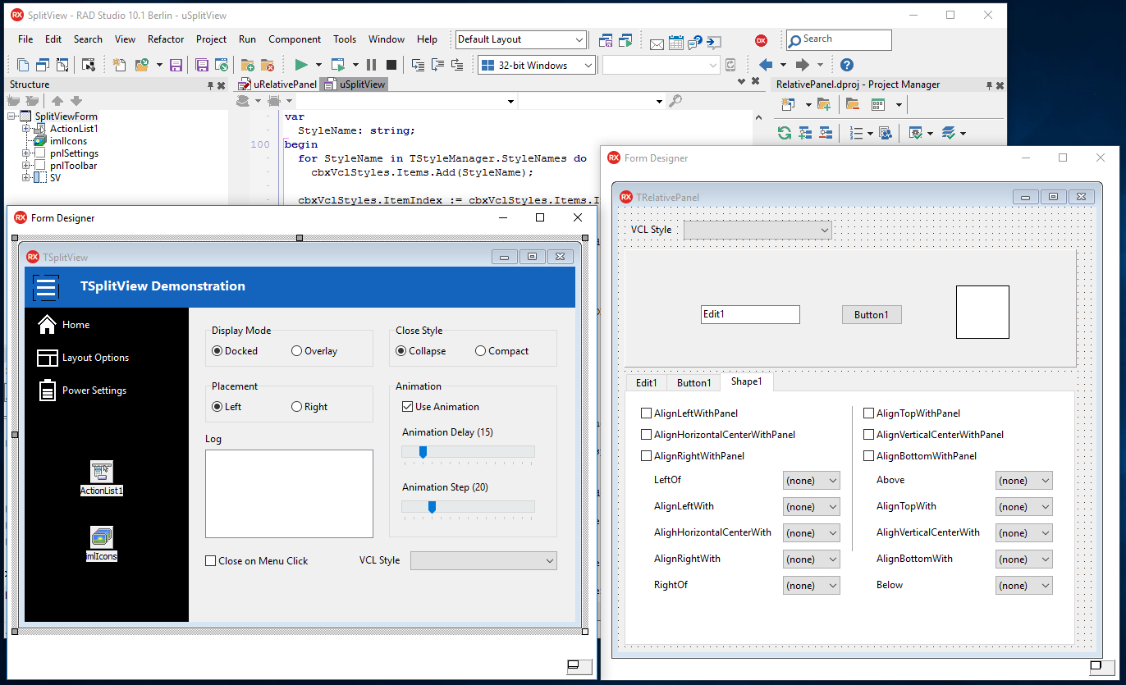
Floating vcl form designer
Edit code and design side by side
Great for multi-monitor systems

Slide 59
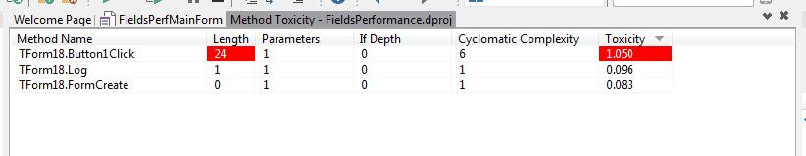
10.1 berlin Productivity enhancements (II)
New Structure View parser for C++
Based on the C++ 11 language specification
IDE shows header dependencies for CLANG-based 32bit C++ compiler
Bookmarks stack
Selection “syntactic” expansion (Ctrl+W)
File associations in the Options dialog
Delphi Methods Toxicity metrics

Slide 60

Quality Performance Stability (QPS)
Significant focus on Quality
25% of planned developers tasks
Covering all areas of the product
High number of fixes and smaller enhancements
744 customer reported bugs closed
Total number of bugs fixed: Over 2,500
Mobile debugging enhancements
CPU View support, Unicode strings evaluation, …

Slide 61

Firedac drivers update
ODBC 3.8 driver
SQLite driver (with 3.9.2 support)
InterBase and Firebird drivers
Service manager, real BLOB streaming
Oracle driver supporting v11g and v12c new APIs
TFDOracleAdmin service and change notifications
Advantage DB driver (version 12)
DB2 driver (with support for AS/400)
PostgreSQL driver (new JSON data types)
Informix driver with better locking support
MongoDB databases improvements and change notifications

Slide 62


InterBase
Most Innovative Use of Data
Embed, Deploy, Relax
Windows, Linux, Android, iOS, Mac OS X
Kick start your applications with must have data security, synchronization and disaster recovery features. Build it once then Embed, Deploy, Relax!

Slide 63
Traditional Data Briefcase
Change
Time
Central DB
Client Cache
4
4
5
5
5
Virtual field packets sent: 4 + 4 + 5 + 5 + 5 = 23

Slide 64
Using Change Views
Change
Time
Central DB
1
Client Cache
1
4
2
1
Virtual field packets sent: 4 + 1 + 2 + 1 + 1 = 9

Slide 65
RAD Server (EMS) extensions
Support for server metadata
Based on Swagger open API
YAML and JSON representations
Can be used for API testing, documentation, faster clients development
ThingPoints “federated” services
Act as a conduit to and from RAD Server (EMS)
Register periphery endpoints with RAD Server
User can reach ThingPoints endpoints via dynamic RAD Server backend endpoints

Slide 66
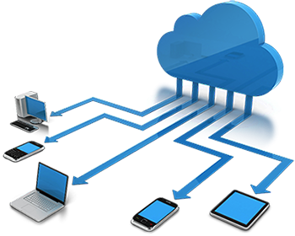
Webbroker, datasnap, Cloud
WebBroker
Now defaults to UTF8
DataSnap
Clients use HTTP client library for both REST and HTTP(S) connections
Server methods support TDBXJSONStream parameters for passing JSON streams
Cloud
Microsoft Azure support updated to latest API
Amazon AWS support updated to latest API

Slide 67
Rad Studio 10.1 Berlin at a glance
New Installer
Making installation and trial a modern, smooth, faster experience
QPS
Quality, performance, stability throughout the entire product
Native
Compiler, libraries, FireMonkey, VCL, Windows 10, mobile…
Developer Productivity
FireUI App Preview on device, floating form designer, and toxicity
IoT
Core technologies enhancements, ThingWare, ThingConnect, ThingPoints
Enterprise Strong
FireDAC database access, EMS REST services, Cloud services

Slide 68
Rad Studio 10.1 Berlin editions
RAD Studio
Professional
FireDAC AddOn
Enterprise
Architect
(Embeds Ultimate)
Delphi
Starter
Professional
FireDAC AddOn
Mobile AddOn
Enterprise
Architect
(Embeds Ultimate)
C++Builder
Starter
Professional
FireDAC AddOn
Mobile AddOn
Enterprise
Architect
(Embeds Ultimate)

Slide 69
Update subscription is included
Update Subscription Benefits
Instant access to the latest RAD Studio, C++Builder, Delphi
Get new features when new features are added
Includes support
Critical to insure the best user experience and provide customers the most from our developer tools
As of April 19, 2016, we won’t sell licenses without Update Subscription

Slide 70
10.1 Berlin special offers
Introductory 10% off pricing through May 19th!
For RAD Studio, C++Builder, Delphi
For new licenses and updates
Also for FireDAC C/S Add-On and Mobile Add-On
* Not applicable to 5- and 10-pack licenses and other promotional prices

Slide 71
Thanks!
Any questions?
brandon.shopp@embarcadero.com
sarina.dupont@embarcadero.com
marco.cantu@embarcadero.com
jim.mckeeth@embarcadero.com
davidi@embarcadero.com

